Slide 1
Dele CA2
Name: Julio Ho Sheng Yang
& Oat Khan Soe
Admin No: P2317384 , P2340809

Slide 2
Section 1: Objective
To build a GAN that is able to capture the data distribution of the emnist dataset and reproduce it for image generation. The generative network architecture - a discriminative model, generative model, and cross entropy loss function.

Slide 3
Section 1: Background research
In
Introduced by Ian Goodfellow et al. in 2014.
GANs consist of two neural networks: a generator and a discriminator.
The generator creates new data samples, while the discriminator evaluates them against real data to determine authenticity.
The two networks are trained simultaneously in a game-theoretic scenario where the generator aims to fool the discriminator, and the discriminator aims to correctly identify real versus fake samples[1][3][4].
Key Applications:
Image Generation
Image-to-Image Translation
Text-to-Image Synthesis
Data Augmentation
Super-Resolution Image Enhancement

Slide 4
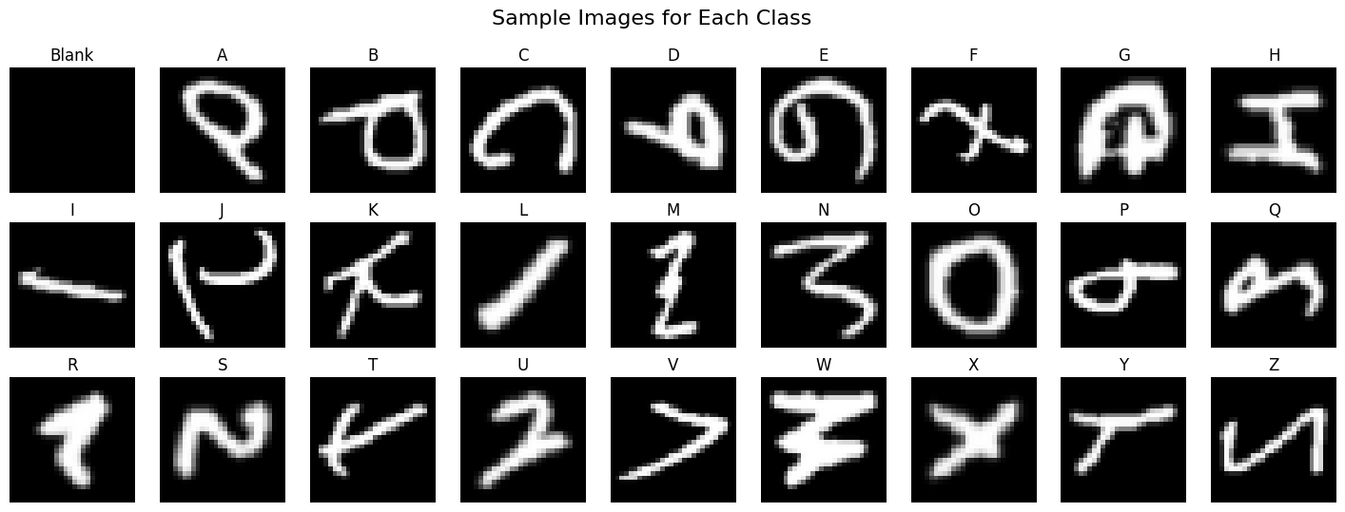
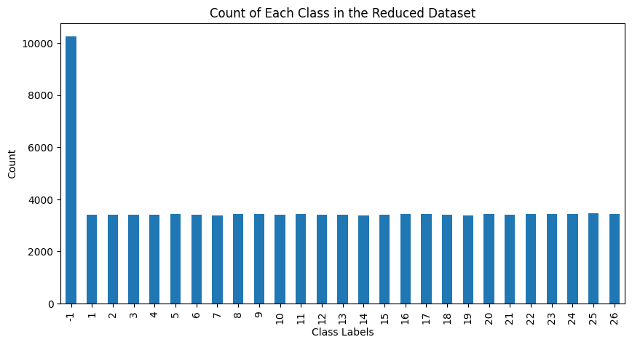
Dataset overview
Current Count of each class
Determine the dimensions and aspect ratio of the images in the EMNIST dataset.
Analyze the distribution of classes across the dataset. (-1 is not balanced)
Verify the alignment between image labels and their corresponding visual content.
27 unique labels
- letters matched are not that very identifiable e.g. some unaligned/not clear need to clean

Slide 5
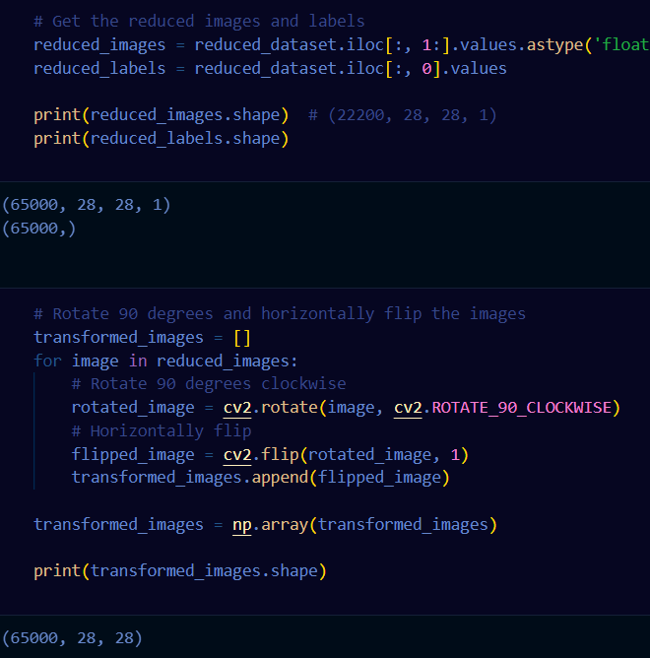
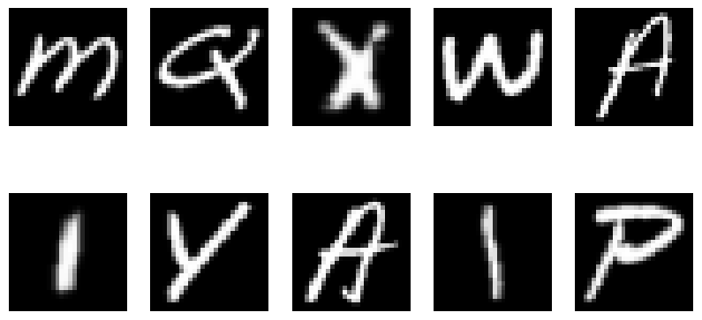
Section 1.1 Exploratory data analysis
Newly transformed labels after rotation
Data Transformation
Unequal distribution of label of the dataset.
What we have to do
Remove the blank label and its associated images from dataset.
Dataset will also be reduced a little bit for memory usage and stop from overfitting.
Images will be aligned for human eye
determination.

Slide 6
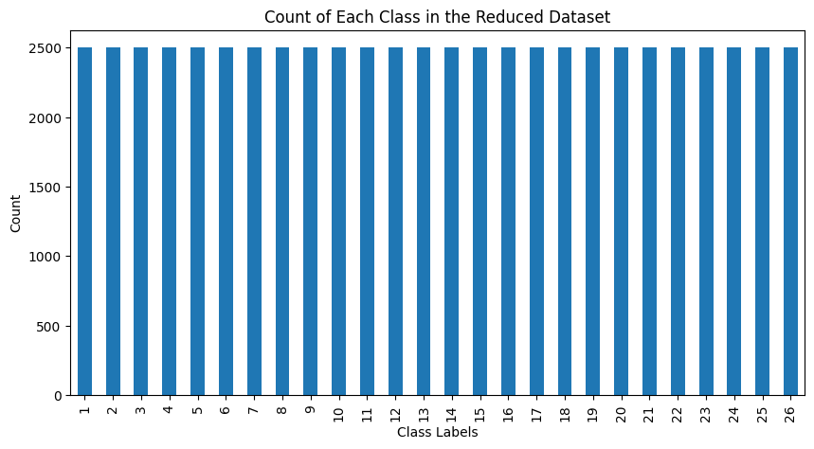
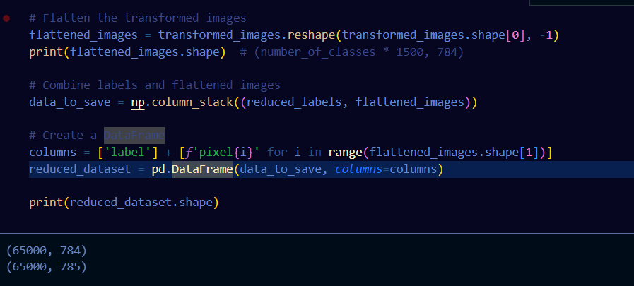
Section 1.2: Feature engineering Balancing the data
Now Data is balanced and easy to identify
Flattened data before saving data dataframe as 'filtered_data.csv'

Slide 7
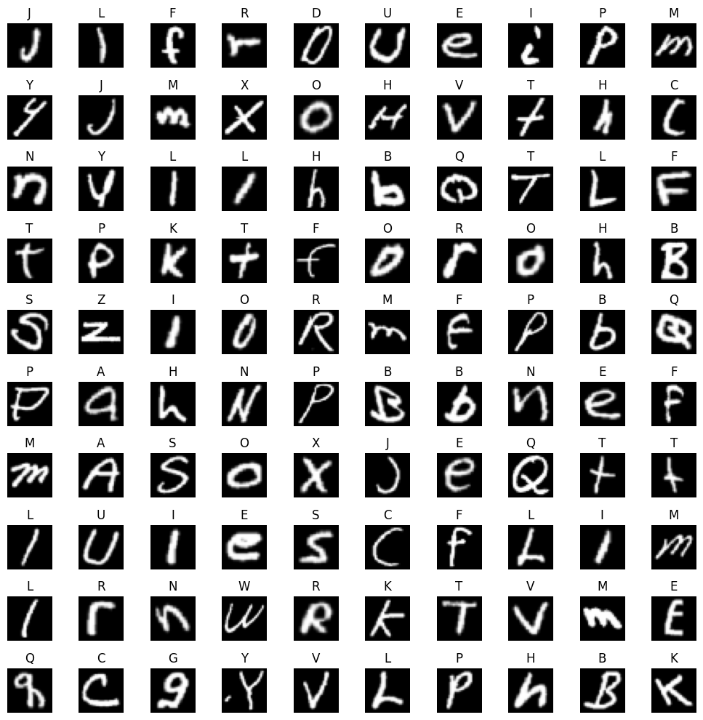
Final product of our eda before we proceed
Normalise the data and one encode it
Took random 100 image to visualise the current lavels as you can see it is much more identifiable compared to the uncleaned/original data

Slide 8
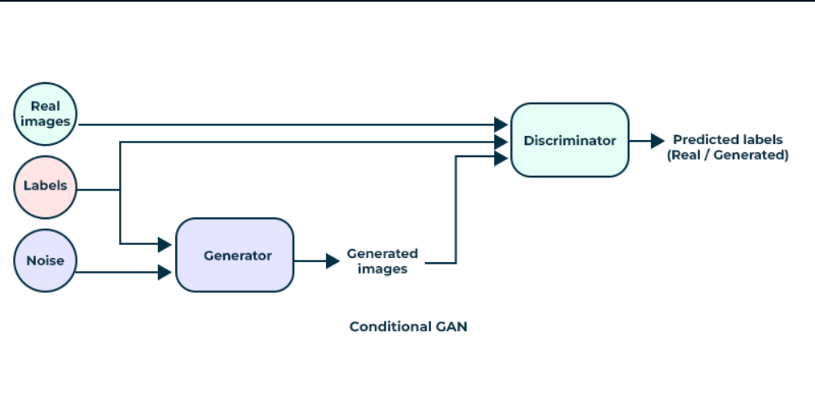
Section 2 Application of GAN, explanation of architecture(s)
Objectives:
Generator : to reproduce synthetic data samples
- (similar to training data) from a latent vector
- (usually as a Gaussian noise).
Discriminator : to distinguish samples from the real dataset and the generator.

Slide 9
Section 2.1: Model architecture
Discriminator and Generator:
[1] One issue of implementing GAN is the instability of its training. In 2018, the introduction of spectral normalization was proposed to stabilize the training of the discriminator.
[2] Spectral Normalization since then have proven to be effective in training Adverserial Networks and its variations.
The generator uses transposed convolutions for up-sampling, which helps in creating high-resolution images from the initial noise vector.
PReLU activation is used for improved learning of features, allowing the network to adaptively learn the activation function parameters.
The generator is designed to produce realistic 28x28 grayscale images from random noise inputs, working in tandem with the discriminator in the GAN framework.

Slide 10
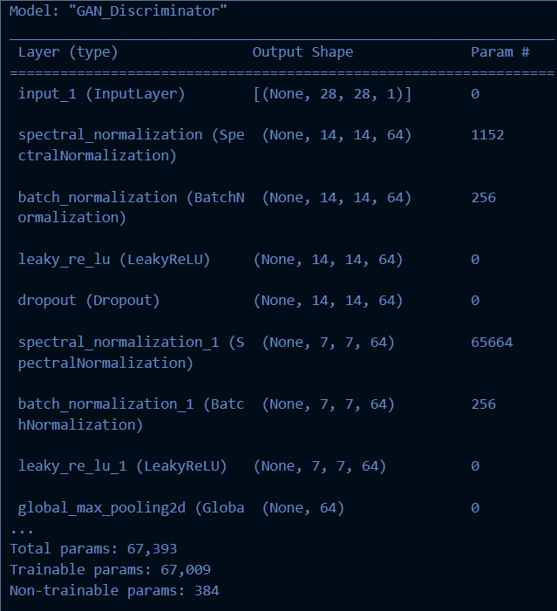
Section 2.1: Gan(baseline) discriminator architecture
Uses spectral normalization for improved stability
This structure allows the discriminator to effectively distinguish between real and generated images, providing feedback to improve the generator's performance.

Slide 11
Gan(baseline) generator architecture
. In a nutshell
This generator architecture is designed to
create realistic EMNIST-like images from
random noise inputs, working in tandem with
the discriminator in the GAN framework.
Uses transposed convolutions for upsampling
PReLU activation for improved learning of features
Generates 28x28 grayscale images from random noise

Slide 12
Section 2.2 Training process
Discriminator Weight Update
Update the weights of the discriminator based on the loss calculated from real and generated images.
Generator Weight Update
Update the weights of the generator based on the loss calculated from the discriminator’s feedback.
Gradient Clipping
Gradient clipping is required in GANs to stabilize the training process by preventing the gradients from becoming too large.
Discriminator and Generator

Slide 13
Section 3 Evaluation and improvement of GAN performance
Objectives:
To find out the best model as we will compare them with eye evaluation
Models we will be trying: GAN , CGAN , ACGAN
Steps:
Builds the model
Generates a summary
Creates random noise to generate 100 images
Displays 50 of them randomly
This visual inspection helps assess the quality of the generated images

Slide 14
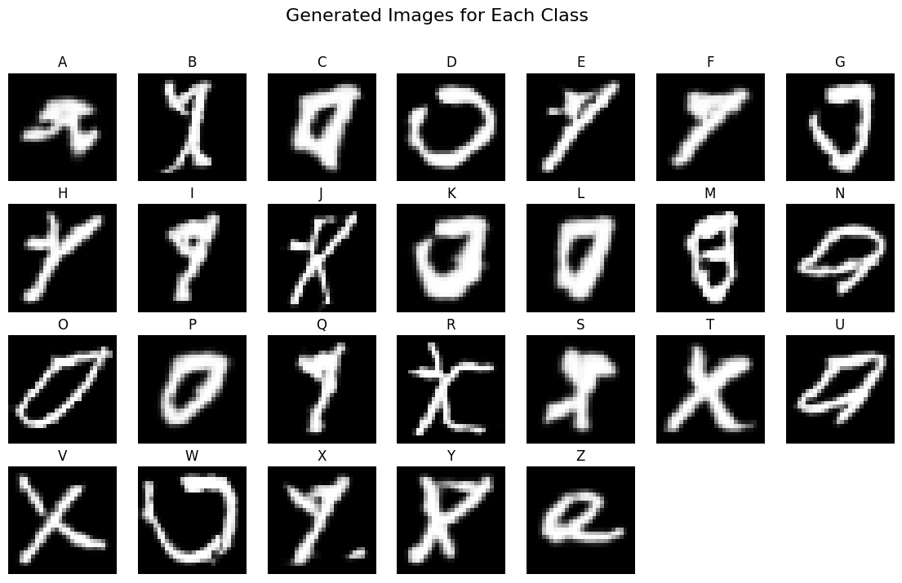
Gan results
Evaluating synthetic images with Eye:
We could not tell which class is generated better than the other classes after generating over 1000 images to tell the problem in image generation.
Hence , we will be using an image classifier we built on this EMNIST dataset.
By using this classifier, we can gain a better intuition about the performance of our GAN and which classes are lacking behind.

Slide 15
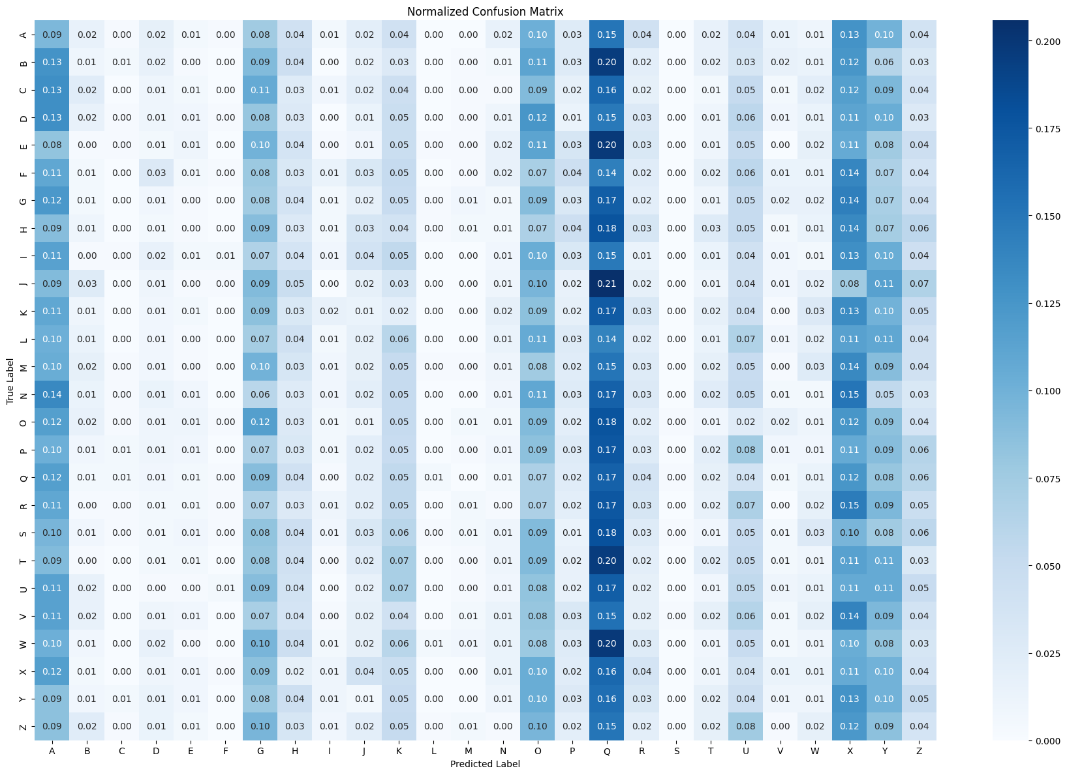
Gan: Classification report
Objective: Evaluate synthetic images using a ResNet model.
Process: Generate predictions for synthetic images.
Compare predicted classes with true classes.
Insights
- Class 'A', 'G', 'K', 'O', 'X' and 'Y' are produced a lot compared to other classes.
- Class 'Q' is the most dominant class produced by the Generator.

Slide 16
Improvements for gan
Further Improvements
- Generated images are not in clear quality, it is hard to identify some image.
- Some Classes are very dominating and Some Classes are not produced at all.
- SpectralNormalization and Weights Initialization could have too much regularization effect on the networks.
Further Improvements
Architecture Modifications: Experimenting with deeper or more complex generator and discriminator architectures.
Hyperparameter Tuning:
Fine-tuning learning rates, batch sizes, and other hyperparameters.
Conditional GAN:
Implementing a conditional GAN to have more control over the generated classes.
Improved Training Techniques:</strong> Exploring progressive growing of GANs or other advanced training strategies.

Slide 17
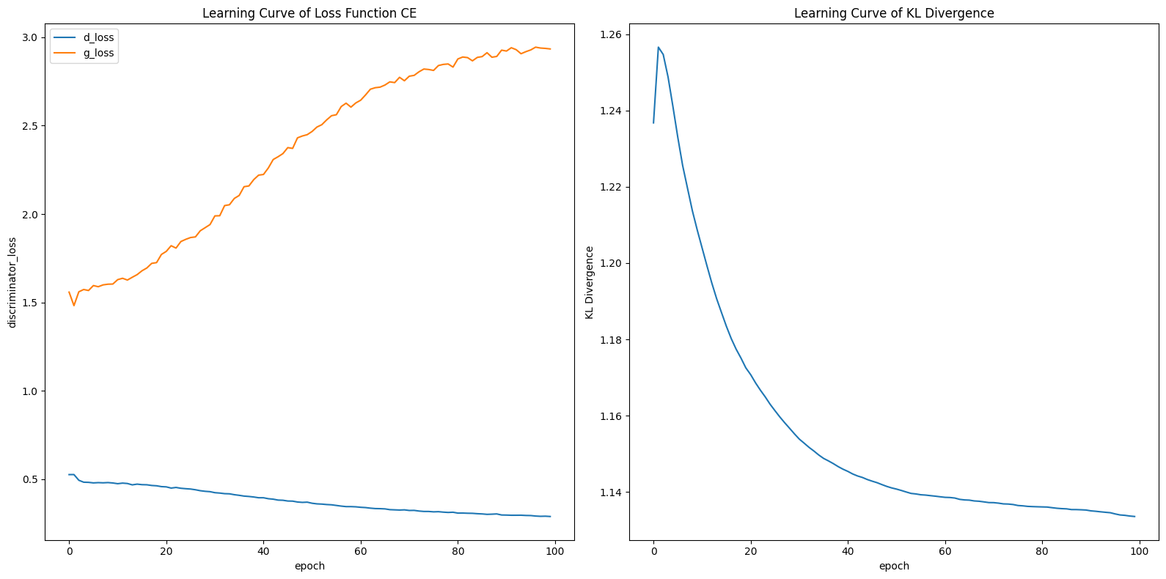
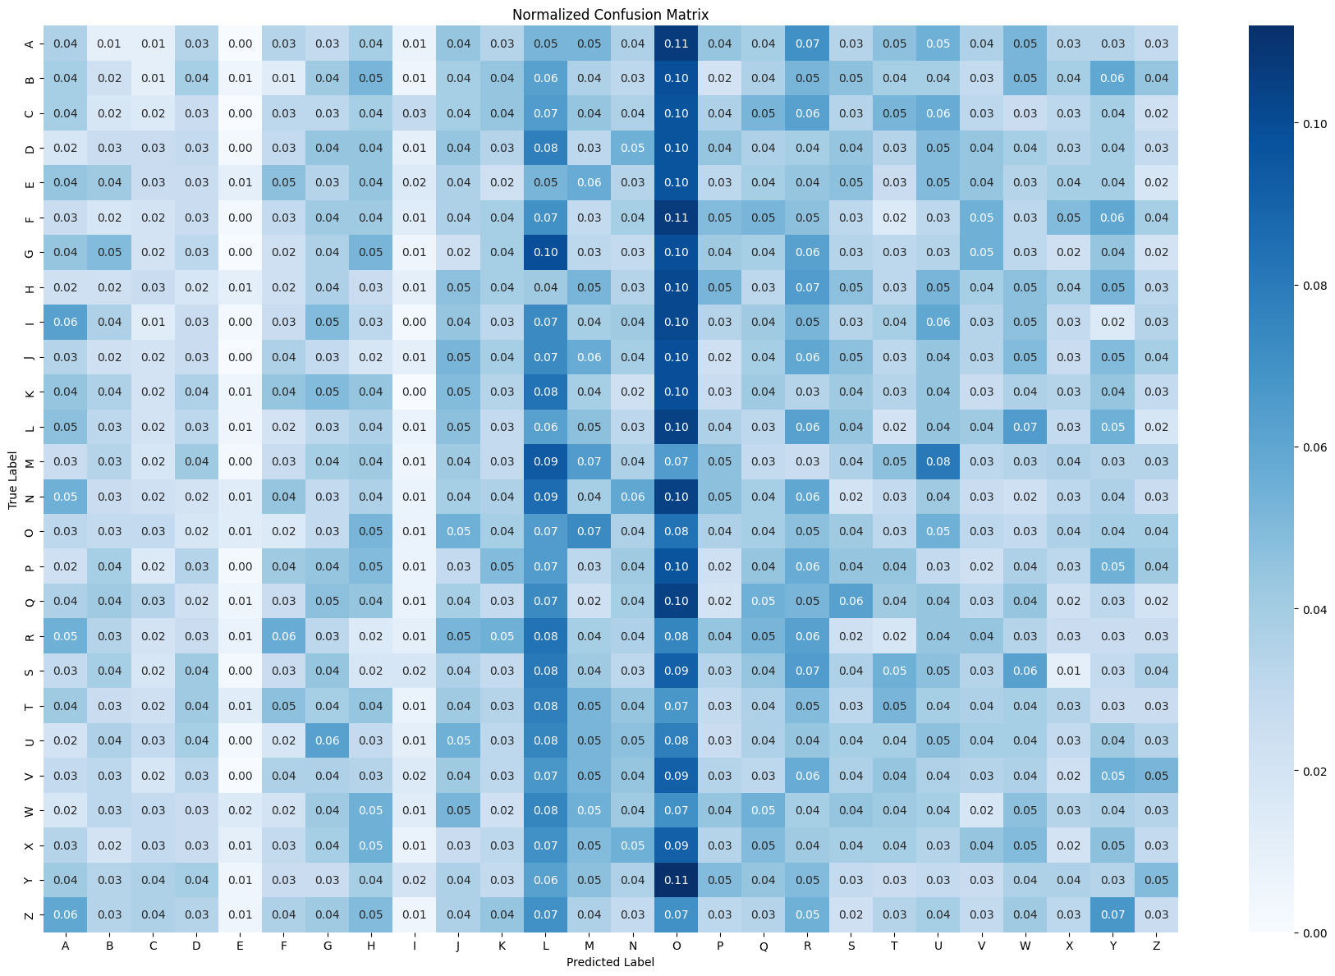
Cgan results
Insights
- Class 'I', and 'L' are confused in image generation.
- Class 'O' is the most dominant class produced by the Generator.
- Class E is not produced.
- Generated images are not in clear quality, it is hard to identify some image.
- Some Classes are very dominating and Some Classes are not produced at all.
- Only 'O' is correctly identified by CNN.

Slide 18
Improvements for cgan
Conclusion and Further Improvements
- Generated images are not in clear quality, it is hard to identify some image.
- Some Classes are very dominating and Some Classes are not produced at all.
- Only 'O' is corretly idnetified by CNN.
Further Improvements
Architecture Modifications:
Experimenting with deeper or more complex generator and discriminator architectures.
<Advanced GAN Variants:
Making better use of the Labels could improve image generation quality (ACGAN, Semi-Supervised GAN)
Hyperparameter Tuning:
Fine-tuning learning rates, batch sizes, and other hyperparameters.
Improved Training Techniques:
Multiple Generator Update per Discriminator Update.

Slide 19
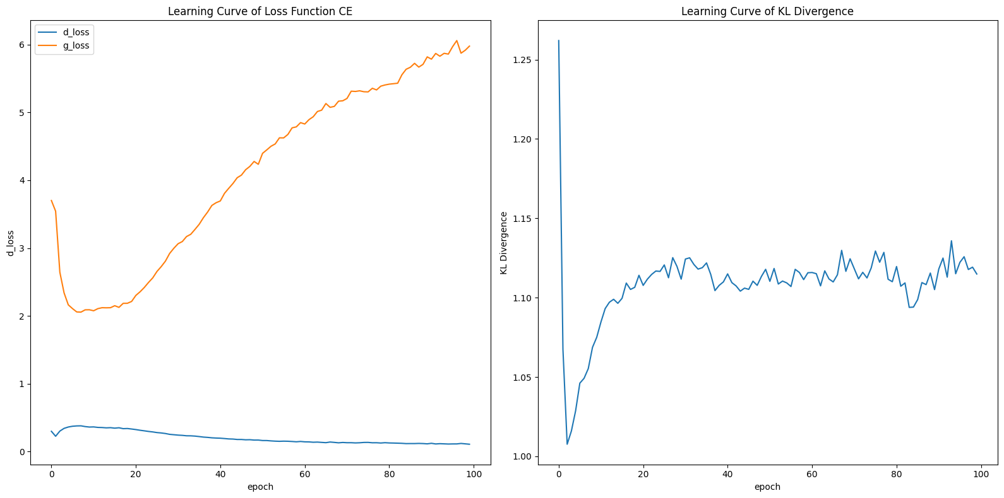
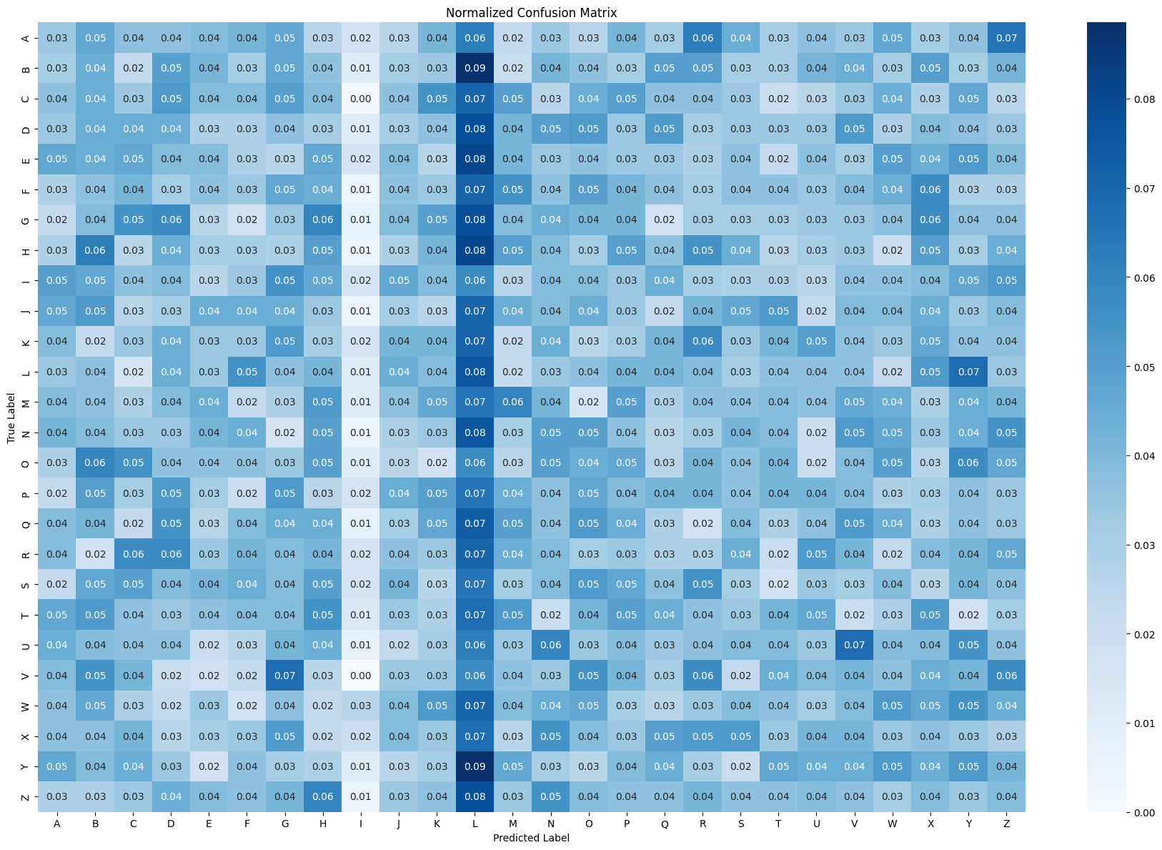
acgan
- CLass 'I', and 'L' are confused in image generation.
- Class 'L' is the most dominant class produced by the Generator.
- Every class is produced apart from 'I’.
- Generated images have clear quality enough to at least be predicted by CNN..
- Some Classes are still very dominating.

Slide 20
Improvements for agan
Conclusion and Further Improvements
- Generated images have clear quality enough to at least be predicted by CNN..
- Some Classes are still very dominating.
Improvements that could have been done
Attempt to change loss function, e.g. Hinge Loss, Wasserstein Loss
Label Smoothing
Multiple Generator Update per Discriminator Update
Differentiable Augmentation

Slide 21
Section 4: improvement of gan performance
Process: Generate 260 images from our best models with earlier mentioned such as hyperparameter tuning etc
Prediction accuracy and visicibiltiy

Slide 22
Conclusion and final takeaways
The quality of generated images improved over iterations, but class imbalance remained a persistent issue.
The use of a CNN classifier provided valuable insights into the performance of the GAN models.
Spectral normalization and weight initialization may have had an overly strong regularization effect.

Slide 23
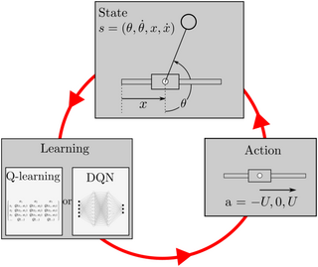
Part b: RL Solving Pendulum Problem with Reinforcement Learning
Objectives:
To build a reinforcement learning network that is
able to solve the pendulum problem of the open ai
gym. The reinforcement learning network
would be based on a DQN architecture – actor
network, critc network, replay and Q-function.

Slide 24
Section 1: Background research
OpenAI Gym is a toolkit for developing and comparing reinforcement learning (RL) algorithms.
It provides a standardized interface for various environments, making it easier to design, train, and evaluate RL models.
- Gym offers a wide range of environments, from simple tasks to complex simulations, enabling consistent benchmarking and experimentation.
- The Pendulum-v0 environment in Gym simulates a pendulum that starts in a random position and must be swung up and balanced. This environment is commonly used to test continuous action space algorithms, as it requires learning precise control strategies.
Importance: RL is crucial for tasks requiring sequential decision-making and control, such as robotics, game playing, and autonomous driving.

Slide 25
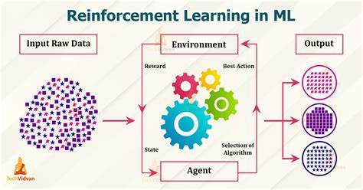
Dqn architecture DQN combines Q-learning with deep neural networks. Components:
Input Layer: Takes the state of the environment as input.
Hidden Layers: Multiple layers with activation functions (e.g., ReLU).
Output Layer: Outputs Q-values for each action.
Deep Q-Network (DQN)
Approach: DQN is a value-based RL algorithm that approximates the Q-value function using a neural network. It estimates the expected return of taking specific actions in given states.
Normalized Advantage Functions (NAF)
Approach: NAF extends DQN to continuous action spaces by decomposing the Q-value function into a value function and a quadratic advantage function.
Advantages: Enables precise control strategies in continuous action environments (e.g., balancing the pendulum).
Deep Deterministic Policy Gradient (DDPG)
Approach: DDPG is an actor-critic algorithm. The actor network determines continuous actions, and the critic network evaluates them. It uses deterministic policies (specific action per state).
Advantages: Excels in continuous action spaces, learning both policy (actor) and value function (critic) for efficient control (e.g., Pendulum-v0).
Twin Delayed DDPG (TD3)
Approach: TD3 improves upon DDPG by addressing limitations (e.g., overestimation bias). It introduces two critic networks and delays policy updates for stability.
Advantages: Highly effective for complex control tasks in continuous action spaces (e.g., Pendulum-v0).

Slide 26
Normalized Advantage Function (NAF)
V Model (State Value Function)
The V model contributes to Q-value calculation by serving as a baseline against which the advantage function (L model) is normalized. This normalization helps stabilize the learning process, especially in environments with varying rewards.
Mu Model (Policy Function)
The mu model outputs the mean action (best guess) for a state. It combines with the L model to compute the advantage function, measuring how much better an action is compared to the average action predicted by the policy.
L Model (Advantage Function)
The L model computes the advantage of a specific action over the mean action suggested by the mu model. Normalization and combination with the V model yield the final Q-value, ensuring stability during learning.
V model , MU model , L model

Slide 27
Experience replay and target networks
Experience Replay
Memory Buffer:
A deque is used to store experiences (state, action, reward, next_state, done) to break correlations between consecutive experiences.
Batch Sampling:
Random samples from the memory buffer are used to train the model, improving learning stability and efficiency.
Explain the concept of experience replay and its importance.
Describe the role of the target network in DQN.

Slide 28
Section 2.2 Training process
Experience Replay: Helps in breaking the correlation between consecutive experiences.
Target Network: Stabilizes training by reducing oscillations in Q-values.
Model Saving: Ensures that the best models are saved for future use.
Episodes
Steps per Episode
Experience Replay
Target Network

Slide 29
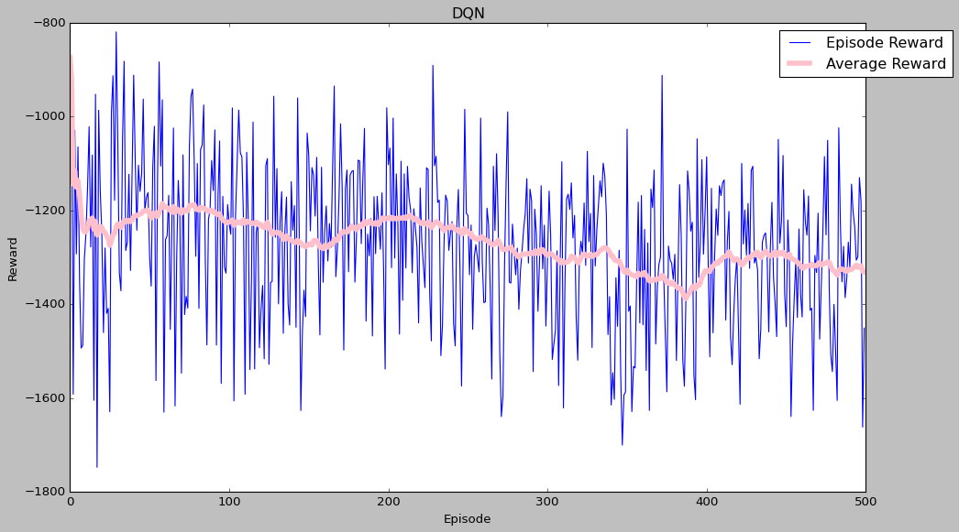
Reward function
Explanation:
The reward function guides the learning process by providing feedback.
Reward Calculation:
Reward is based on the angle and angular velocity of the pendulum.
Initially, the agent explores various actions, leading to high variance in rewards.
As it learns, the “Average Reward” becomes more stable.
Learning Progress:
The AI agent adjusts its policy (strategy) based on the reward feedback.
Over time, it refines its actions to maximize rewards.
The goal is to converge toward a policy that balances the pendulum effectively.
Optimization:
The agent seeks to find the optimal balance between keeping the pendulum upright (minimizing angle deviation) and minimizing motion (angular velocity).
It also avoids excessive control inputs (large torque).

Slide 30
Normalized Advantage Function (NAF)
V Model (State Value Function)
The V model contributes to Q-value calculation by serving as a baseline against which the advantage function (L model) is normalized. This normalization helps stabilize the learning process, especially in environments with varying rewards.
Mu Model (Policy Function)
The mu model outputs the mean action (best guess) for a state. It combines with the L model to compute the advantage function, measuring how much better an action is compared to the average action predicted by the policy.
L Model (Advantage Function)
The L model computes the advantage of a specific action over the mean action suggested by the mu model. Normalization and combination with the V model yield the final Q-value, ensuring stability during learning.
V model , MU model , L model

Slide 31
Section 3.1 model improvement
NAF Model Improvement
The improved NAF model incorporates several advanced
techniques to enhance performance:
- Prioritized Experience Replay
- Ornstein-Uhlenbeck Action Noise
- Ensemble Training
Model Architecture
The model consists of three main components:
- V-Model (Value Function)
- L-Model (Advantage Function)
- Mu-Model (Policy Function)
Each model uses a similar architecture:
- Two dense layers with 64 units and ReLU activation
- Batch normalization after each dense layer
- Output layer specific to each model's purpose

Slide 32
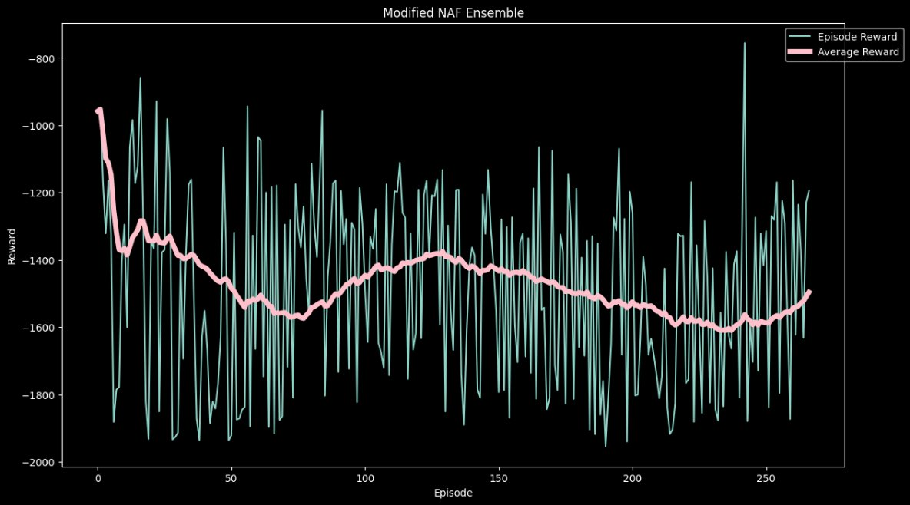
Episodic Reward and Average Reward:
Pink line represents the immediate reward obtained by the AI agent after each episode.
It reflects the quality of the agent’s actions during training.
.
Average Reward
The average reward provides a more stable view of the agent’s performance over multiple episodes.
The upward trend in the average reward suggests that the AI agent is learning and making better decisions over time.

Slide 33
Improvements for naf
Improvements Over Basic NAF
- Prioritized Experience Replay: Focuses on important experiences, leading to faster and more stable learning.
OUActionNoise:
Provides better exploration in continuous action spaces.
- Ensemble Training: Reduces variance and improves robustness of the learned policy.
Gradient Clipping:
Prevents unstable updates due to large gradients.
- Enhanced Visualization: Includes GIF creation and reward plotting for better analysis.

Slide 34
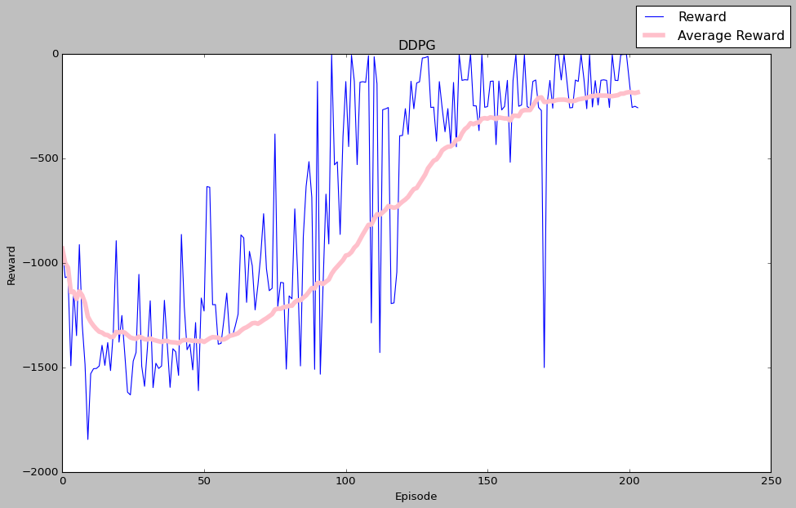
ddpg
The Average Reward line shows a smoother trend.
It gradually increases over time, suggesting and achieving better performance on average as training progresses.
Overestimation Bias:
(Common in Q-learning methods).
However, in this case, the Average Reward is higher, suggesting that the model is not overly optimistic.
Insight: The model appears to handle overestimation bias well thus model is good.

Slide 35
Improvements for naf
Key points
Gradient Clipping:
- Although not explicitly implemented in this version, gradient clipping can be added for further stability.
- Gradient clipping limits the magnitude of gradients during backpropagation, preventing large updates.
Batch Normalization:
- Batch normalization is not used in this specific implementation.
- However, it could be added to improve training stability by normalizing layer activations.
Overall, By combining value-based and policy-based methods, DDPG is well-suited for environments with continuous action spaces. 🚀

Slide 36
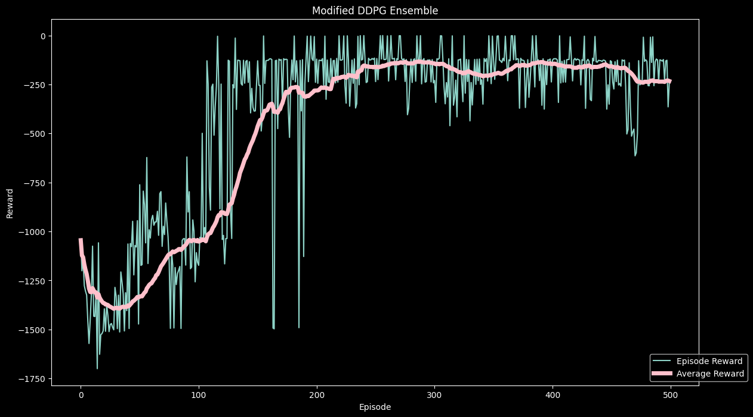
ddpg
The Average Reward line shows a smoother trend. It gradually increases over time, suggesting overall improvement.
Insight: Similar to the modified DDPG, our TD3 model is learning and achieving better performance on average as training progresses.
.

Slide 37
Improvements for ddpg
Batch Normalization:
Batch normalization normalizes layer activations, making training more robust and accelerating convergence.
Implementation:
Add batch normalization layers after relevant layers (e.g., fully connected
or convolutional layers).
DDPG combines value-based (Critic) and policy-based (Actor) methods
Effectively. It’s well-suited for environments with continuous action
spaces.

Slide 38
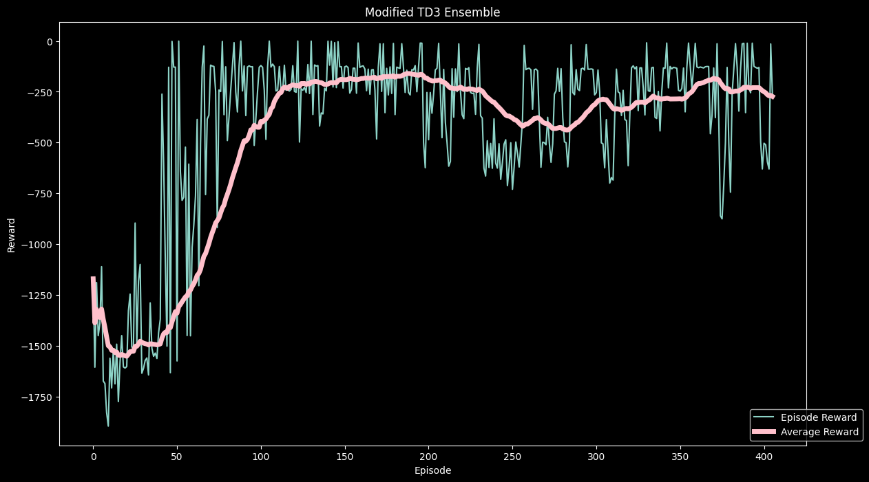
Saving our best models
TD3 is the best with the most consistent performance

Slide 39
conclusions
The DQN implementation for the pendulum balancing task successfully demonstrated the application of reinforcement learning in continuous control environments. The model's ability to learn and perform the task effectively highlights the potential of DQN in solving complex control problems.

Slide 40
references
References
Goodfellow, I., Pouget-Abadie, J., Mirza, M., Xu, B., Warde-Farley, D., Ozair, S., Courville, A., & Bengio, Y. (2014). Generative Adversarial Nets. Advances in Neural Information Processing Systems, 27. Retrieved from https://papers.nips.cc/paper/5423-generative-adversarial-nets.pdf
Mnih, V., Kavukcuoglu, K., Silver, D., Rusu, A. A., Veness, J., Bellemare, M. G., ... & Hassabis, D. (2015). Human-level control through deep reinforcement learning. Nature, 518(7540), 529-533. doi:10.1038/nature14236
Lillicrap, T. P., Hunt, J. J., Pritzel, A., Heess, N., Erez, T., Tassa, Y., ... & Wierstra, D. (2016). Continuous control with deep reinforcement learning. arXiv preprint arXiv:1509.02971. Retrieved from https://arxiv.org/abs/1509.02971
Schaul, T., Quan, J., Antonoglou, I., & Silver, D. (2015). Prioritized Experience Replay. arXiv preprint arXiv:1511.05952. Retrieved from https://arxiv.org/abs/1511.05952
Heess, N., Hunt, J. J., Lillicrap, T. P., & Silver, D. (2015). Memory-based control with recurrent neural networks. arXiv preprint arXiv:1512.04455. Retrieved from https://arxiv.org/abs/1512.04455
Haarnoja, T., Zhou, A., Abbeel, P., & Levine, S. (2018). Soft Actor-Critic: Off-Policy Maximum Entropy Deep Reinforcement Learning with a Stochastic Actor. arXiv preprint arXiv:1801.01290. Retrieved from https://arxiv.org/abs/1801.01290
OpenAI Gym Documentation. Retrieved from https://www.gymlibrary.dev/environments/classic_control/pendulum/
TensorFlow Documentation. Retrieved from https://www.tensorflow.org/api_docs/python/tf/keras
Keras Documentation. Retrieved from https://keras.io/api/

Slide 41
contributions
For both Part A and B:
Oat Khan Soe Percentage of Workload: 55%
• Data Preprocessing: Responsible for cleaning, normalizing, and preparing the dataset for training. Ensured that the data was in the correct format and handled any missing or inconsistent data points.
• Implementing DQN: Developed and implemented the Deep Q-Network (DQN) architecture. This included designing the neural network, defining the loss functions, and setting up the training loop.
• Training and Evaluation: Conducted the training of the DQN model, including running multiple training sessions, monitoring performance metrics, and evaluating the model's effectiveness on the test set. Performed iterative improvements based on evaluation results.
Julio Ho Sheng Yang Percentage of Workload: 45%
• Background Research: Conducted comprehensive research on the theoretical aspects of Generative Adversarial Networks (GANs) and Reinforcement Learning (RL). This included understanding the latest advancements, best practices, and potential challenges in implementing these models.
• Model Improvement/Hyperparameter Tuning: Focused on optimizing the hyperparameters of the models. This involved experimenting with different learning rates, batch sizes, and other critical parameters to enhance model performance and stability.
Documentation: Created detailed documentation for the project. This included writing clear and concise explanations of the methodologies used, the results obtained, and the conclusions drawn from the experiments. Ensured that the documentation was well organized and easy to understand for future reference.

